Slide 1
Pt 4: Crystallinity(结晶度) in soft matter Lecture #12 Crystallisation in soft matter
Getting from melt → crystal in soft condensed matter, and in general
Crystallinity in polymers?

Slide 2

Crystallisation: Liquid → Solid phase transition Requires nucleation, similar as for binodal phase separation
At T_{m} solid and liquid have equal Gibbs potentials
ΔH_{m}: Latent heat of melting; ΔS_{m} = ΔH_{m}/T_{m} entropy of melting (Here understood per unit volume, not per mole as usual) P12.1
Thermodynamics assumes ‘infinite’ crystals, ignores surfaces
But crystals start out small…
Nucleation (size r) costs surface energy ~ r²
Undercooling is necessary for crystallisation

Slide 3
Nucleation
Undercooling by ΔT ➔ ΔG_{bulk} = -ΔTΔH_{m}/T_{m}
➔ Favourable ΔG ~ r³ (Volume) for nucleus of radius r
But unfavourable interfacial energy ~ r² (area)
$ΔG\left(r\right)= \frac{4π}{3}r^{3}ΔG_{bulk}+4πr^{2}γ$ = $4πr^{2}γ$ - $\frac{4π}{3}r^{3}\frac{ΔH_{m}}{T_{m}}ΔT$
γ_{SL}: Solid/liquid interfacial energy
Assuming spherical Xtal- not strictly realistic but Vol. ~ r³ / Surf. ~r² is
Notes:
Since delta Sm = dG(solid)/dT - dG(liquid)/dT = delta Hm/Tm [all at constant pressure]

Slide 4
Critical radius
Adding surface and bulk terms together shows that small nuclei raise the Gibbs potential
from SCM
Crystal nuclei (‘embryos’) must overcome r*
before they grow spontaneously P12.2

Slide 5
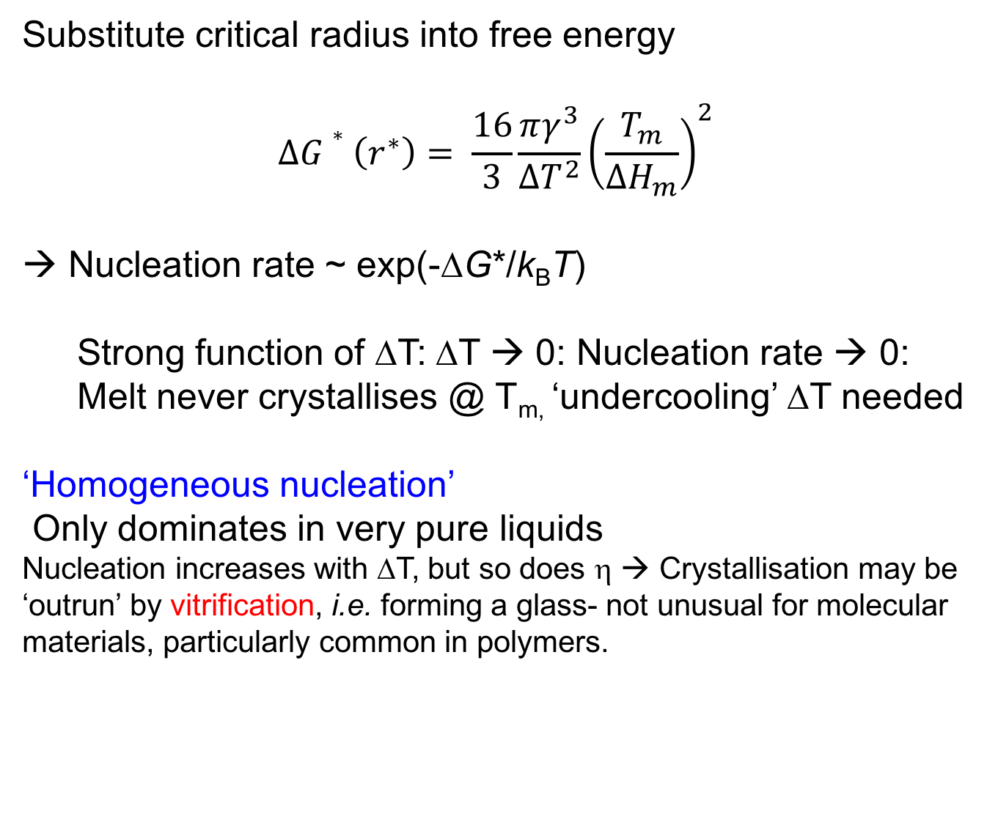
Nucleation and undercooling
Substitute critical radius into free energy
$$ΔG∗\left(r^{∗}\right)= \frac{16}{3}\frac{πγ^{3}}{ΔT^{2}}{\left(\frac{T_{m}}{ΔH_{m}}\right)}^{2}$$
→ Nucleation rate ~ exp(-ΔG*/k_{B}T)
Strong function of ΔT: ΔT → 0: Nucleation rate → 0:
Melt never crystallises @ T_{m,} ‘undercooling’ ΔT needed
‘Homogeneous nucleation’
Only dominates in very pure liquids
Nucleation increases with ΔT, but so does η → Crystallisation may be ‘outrun’ by vitrification, i.e. forming a glass- not unusual for molecular materials, particularly common in polymers.

Slide 6
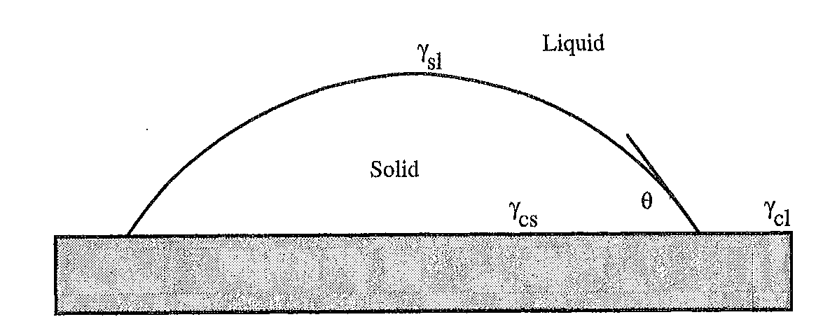
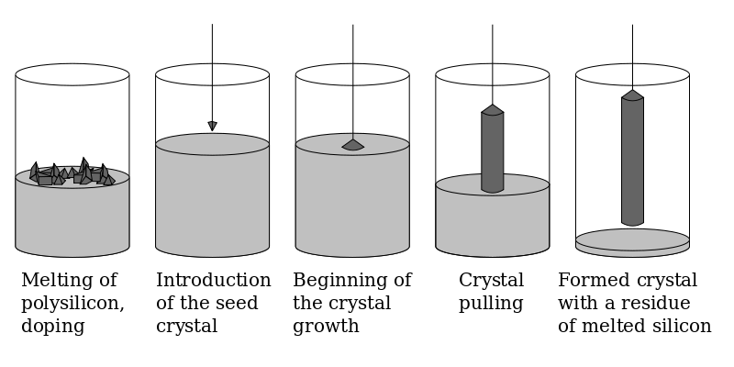
Heterogeneous nucleation Impurities, or vessel walls
‘Flat cap’ geometry at the wall of a vessel geometry reduces ΔG*
ΔG* ~ (1-cosθ)²(2+cosθ) → 0 for θ → 0
Practically, heterogeneous nucleation usually dominates
‘Ideal’ heterogeneous nucleus:
Seed crystal of same material, > r*
‘Czochralski process’, Si single Xtals
Notes:
ΔG* here is simply the previous ΔG* multiplied by V/(4πr³/3)

Slide 7
Crystallization rate: Growth of nuclei
Avrami equation is primitive description of crystallization kinetics.
Still commonplace, often used for polymers
φ_{cr} = 1 - exp(-Kt^{n})
K= K(T), t time, and φ_{cr} crystallized volume fraction (‘degree of crystallinity’)
Avrami theory: n is an integer, between 1 and 4
Now n is regarded as a fit parameter, not always integer
But note: For polymers, real φ_{cr} does not approach 1 for t → ∞
Avrami plot $\ln\left(\ln\left(\frac{1}{1−Φ_{c}r}\right)\right) vs. ln⁡(t)$: straight line, slope n
Notes:
n = 1, 2, and 3 for each dimension, because the growth of each lamellae is proportional to t. Instantaneous crystallization has an Avrami exponent 3, because nucleation is no longer time dependent. The preceding sentence applies to only early times because it is linear in t. In reality, crystallization depletes the bulk polymer of material to crystallize, so the decaying exponential is more appropriate (and can be mathematically proven). Of course, Avrami behaviour is a bit hand-waving and divorced from reality.

Slide 8
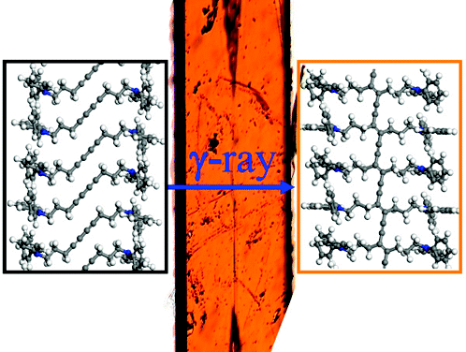
Crystallinity in polymers ?
Crystals of ‘small’ materials are not usually perfect
- vacancies, interstitials, dislocations, grain boundaries/twinning,...
But: In principle, ‘infinitely’ large in 3 dimensions
Some polymers may crystallise, but…
→ Not all polymers can- depends on molecular architecture
→ Even in polymers that can- Xtallinity often frustrated by vitrification ‘quenching’
→ Polymer crystals are not ‘infinite’ in all 3 dimensions
Always finite in the axis // chain backbone
Flat sheets (‘lamellae’): Surface energies never fade away
→ Some non- crystalline regions always remain: ‘Degree of crystallinity’ Φ_{cr} < 1
→ Permanent non- equilibrium state, incomplete order, hierarchies of structure
OK there’s one exception:
‘Topochemical polymerisation’
e.g. Polydiacetylene
G Wegner Z. Naturforschg. 24b, 824 (1969)

Slide 9
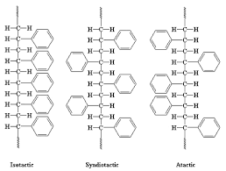
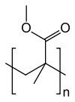
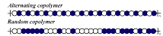

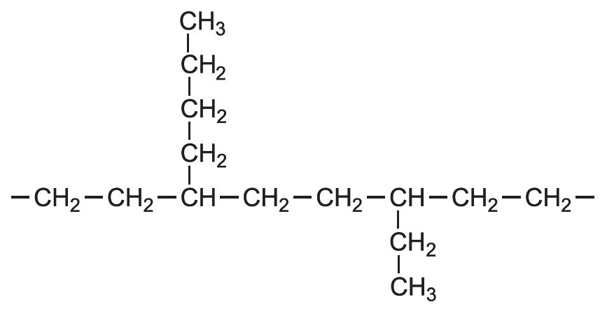

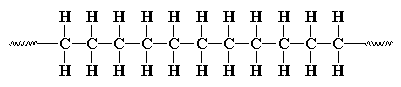
Polymer structure ←→Xtalisation
(Lack of) tacticity, e.g. PS,
PMMA aka ‘Perspex’
or alternating vs. random copolymers
? highly Xtalline amorphous, T_{G} ~ 100 ºC
‘Quenched disorder’ impedes Xtallinity
Branching, e.g. LDPE vs. HDPE

Slide 10
Summary Lecture #12 Crystallisation in soft matter
Crystallisation needs nucleation
Homogeneous nucleation needs supercooling
no crystallisation at T_{m}
Often heterogeneous nucleation dominates
Crystallisation kinetics often fitted by Avrami eq.
Some Polymers also can crystallise
Others can’t, depends on ‘quenched disorder’ in chain architecture
Polymer Xtallisation slow, can be ‘quenched’
Polymer Xtals don’t extend → ∞ in all directions
Polymers don’t crystallise fully; Φ_{cr} < 1
Some of this is in SCM 3.4.1

Slide 11
Lecture #13 Polymer crystallisation I
Experimental study of Polymer Crystallinity
- Calorimetry, X-rays, polarisation microscopy
Polymer crystal morphologies
- Lamellae, spherulites, shish kebabs

Slide 12
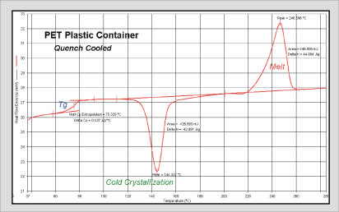
Measuring/quantifying polymer crystallinity
‘DSC’: Differential Scanning Calorimeter
Example DSC scan:
→ Measures flow of heat as T is ramped
up or down, ≈ (5…10) ºC/min
Glass transition: Step up
Crystallisation: Peak down
Area = Heat of fusion
Melting: Peak up
Area = Latent heat of melting
T →
Polymers often Xtallise on heating
Then melt again at higher T

Slide 13
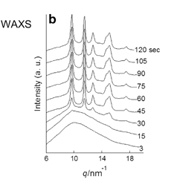
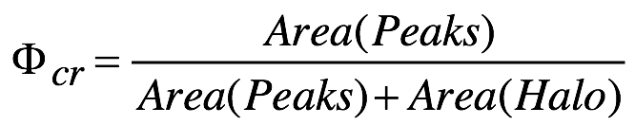
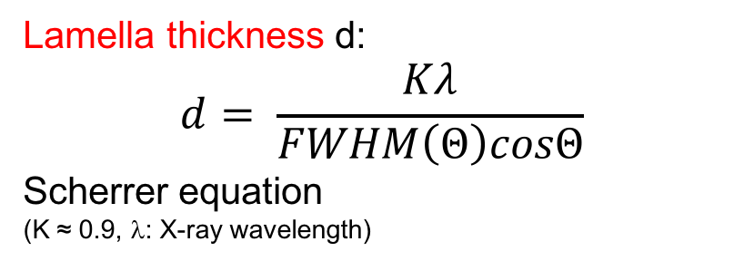
Measuring/quantifying polymer crystallinity
‘WAXS’: Wide- angle X-ray scattering’
wide angle ←→ small size structures
iPP, 137 ºC
Lamella thickness d:
$$d= \frac{Kλ}{FWHM\left(Θ\right)cosΘ}$$
Scherrer equation
(K ≈ 0.9, λ: X-ray wavelength)
t = 0: Amorphous ‘halo’
t > 0: Peaks grow as
iPP Xtallises
Sharp- ish Peaks , but
finite width
←→ finite lamella thickness
Typical d ≈ (10… 20) nm
Degree of crystallinity Φ_{cr}
Polymer Journal (2013) 45, 87–93

Slide 14
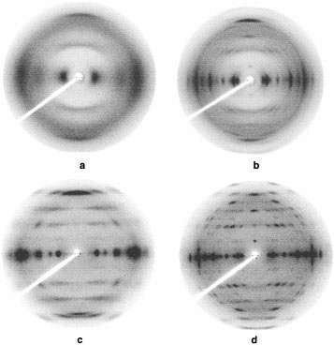
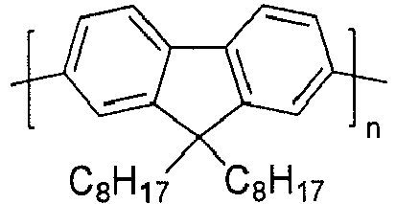
Making polymers Xtallise
X- ray fibre diffraction of
aligned poly(fluorene)
Treatments:
a.) fibre rapidly cooled,
aligned but glassy
b.) thermal crystallisation
Anneal @ favourable T
c.) ‘solvent anneal’
Expose to solvent vapour
d.) b+c combined
fibre axis
Macromolecules 32, 5810 (1999)

Slide 15
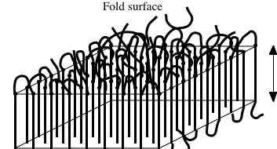
Polymer crystals at nanoscale: Chain- folded lamellae
Lamellae grow sideways by polymer stems joining from melt.
Lamella thickness L ≈ 10nm << contour length Na, ≠ R, independent of N
At surface, chains fold back into lamella, or join other lamella: ‘tie fibril’
Once L is established it does NOT grow
Surface : Bulk remains finite, does not fade → 0
Unfavourable lamella surface energy eats into ΔG gain from crystallisation
Lamellae lock in permanent non- equilibrium, T_{m}(L) < T_{m}(∞)
L
So…
1.) How can we know T_{m}(∞)?
2.) What controls L, if not equilibrium?

Slide 16
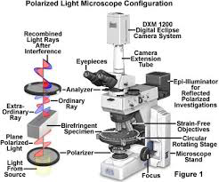
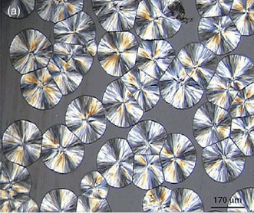

Measuring/quantifying (polymer) crystallinity
B Cheng, JRG Evans, Soft Matter 5, 3572 (2009)
+ hotstage:
Polmiscope sees birefringence
iPP ‘spherulites’ ~ 100 μm scale ‘Maltese Cross’
Much larger than typical lamellae … ? …
Watch them grow over seconds/minutes/hrs
(T – dependent rate)
Also, AFM…

Slide 17
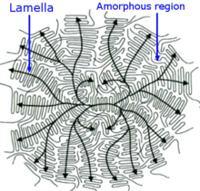
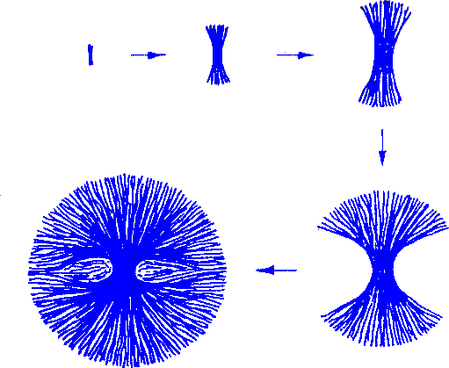

Spherulites: Bundles of lamellae
A spherulite grows by the condensation of chains on them forming more and more lamellae
Image courtesy of Professor A M Donald

Slide 18
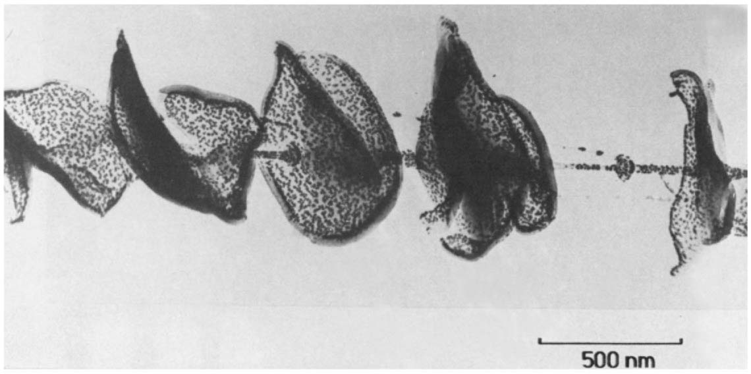
Shish kebabs
Chain-folding occurs in different geometries
does not require pre-existing crystal face
‘Shish’: Crystallised
aligned (stressed) polymer
‘Kebab’: Epitaxial growth
on shish
polyethylene shish kebabs
A. Keller Faraday Discuss. Chem. Soc. 68 145 (1979)

Slide 19
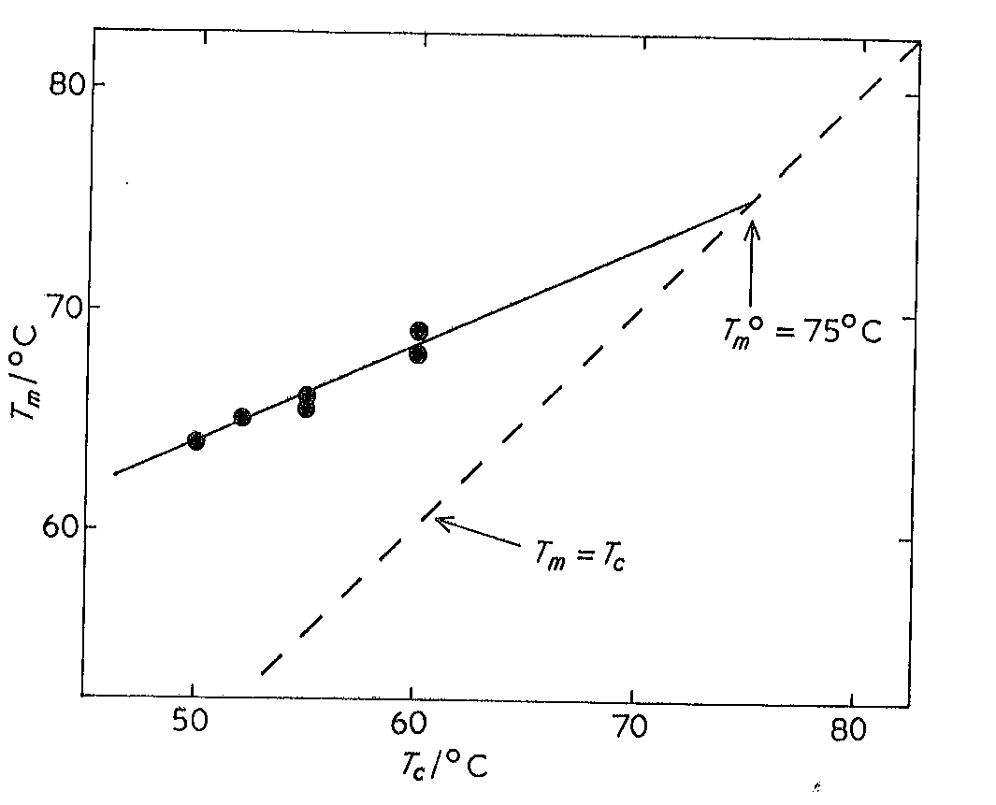
How do we know T_{m}(∞) ?
Crystallise polymer isothermally at T_{c}, T_{G} < T_{c} < T_{m}(∞)
Measure T_{m}, T_{m} > T_{c}: T_{c} < T_{m} < T_{m}(∞)
Repeat for several T_{c} approaching T_{m}(∞)
Plot T_{m}(T_{c}), extrapolate to T_{m} = T_{c} = T_{m}(∞)
T_{m}(∞)
A poly(propylene oxide)
From RL Young,
Introduction to Polymers
P13.1
T_{m}(∞) independent of N / Mol. Wt.
Tabulated in Polymer Handbook
(Or, plot T_{m}-T_{c} vs. T_{c} and extrapolate to zero)

Slide 20
Summary: Lecture #13
Key experimental techniques: DSC, X-ray, Polmiscope
Polymer Xtals = chain folded lamellae
Finite lamella thickness L, T_{m}(L) < T_{m}(∞)
We can find T_{m}(∞) by extrapolation
Lamellae bundle into spherulites, or as ‘shish- kebaps’
- Hierarchy of structures
Some of the material contained within this lecture can be found in SCM 8.2.

Slide 21
Lecture #14 Polymer crystallisation II
Kinetic Theory of polymer chain-folded lamellae
Thermodynamics
Fastest growing length scale
Speed of crystallization

Slide 22
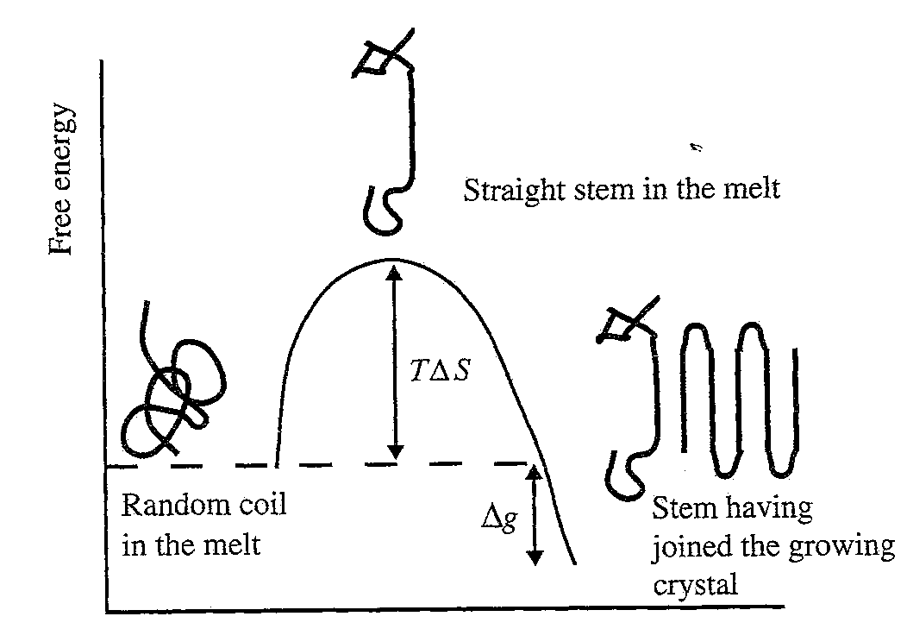
Lamella Thickness L: Growth kinetics
Straightening chain so it can join as a stem costs entropy
before enthalpy gain of crystallization
L is a compromise
Thick lamellae require a high entropic cost to straighten a polymer chain segment
Thin lamellae have too many fold surfaces
Either gives slow
growth rate, ν
L(T_{c}) given by L with fastest ν at given T_{c} < T_{m}(∞)
Notes:
The x axis might as well be time, or something like that

Slide 23
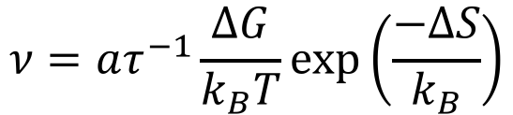
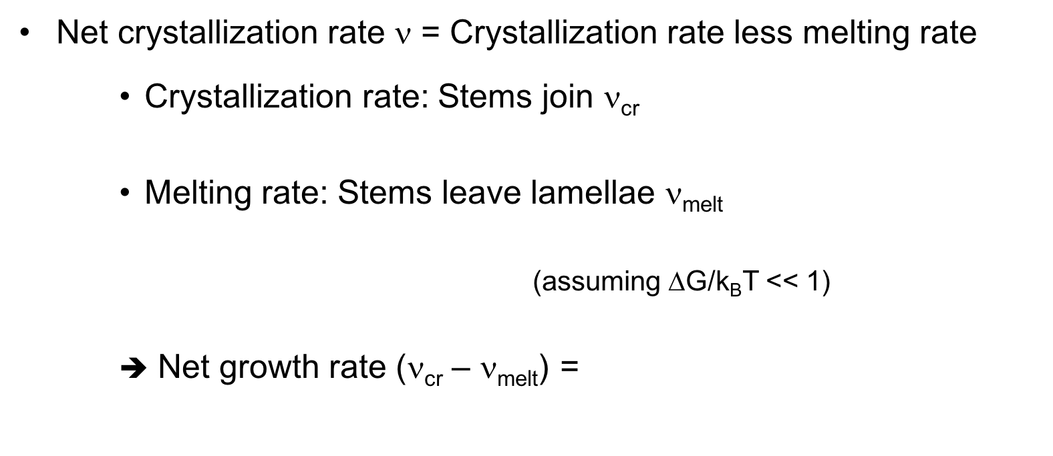
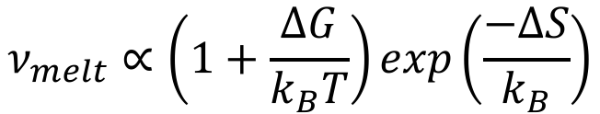
Growth rate: Net crystallisation rate
Net crystallization rate ν = Crystallization rate less melting rate
Crystallization rate: Stems join ν_{cr}
Melting rate: Stems leave lamellae ν_{melt}
(assuming ΔG/k_{B}T << 1)
➔ Net growth rate (ν_{cr} – ν_{melt}) =
$$ν_{melt}∝\left(1+\frac{ΔG}{k_{B}T}\right)exp\left(\frac{−ΔS}{k_{B}}\right)$$
$$ν=aτ^{−1}\frac{ΔG}{k_{B}T}\exp\left(\frac{−ΔS}{k_{B}}\right)$$
τ⁻¹: microscopic ‘trial’ frequency ~ η⁻¹, a = size of repeat unit
ΔS(L), ΔG(L) = ? Then find max. ν(L)

Slide 24
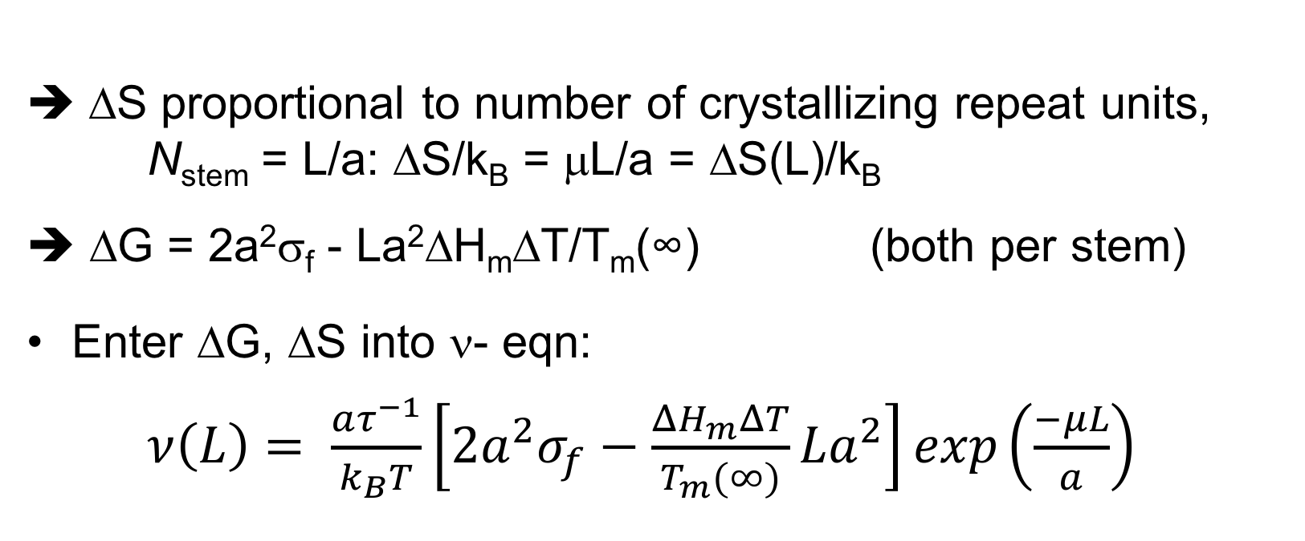
Entropy / Enthalpy of crystallizing chain
ΔS proportional to number of crystallizing repeat units, N_{stem} = L/a: ΔS/k_{B} = μL/a = ΔS(L)/k_{B}
ΔG = 2a²σ_{f} - La²ΔH_{m}ΔT/T_{m}(∞) (both per stem)
Enter ΔG, ΔS into ν- eqn:
$ν\left(L\right)= \frac{aτ^{−1}}{k_{B}T}\left[2a^{2}σ_{f}−\frac{ΔH_{m}ΔT}{T_{m}(∞)}La^{2}\right]exp\left(\frac{−μL}{a}\right)$
Fastest L = L* by dν/dL = 0 ➔ $L^{∗}= \frac{a}{μ}+ \frac{2σ_{f}T_{m}(∞)}{∆H_{m}∆T}=A+ \frac{B}{∆T}$
P14.1
At ΔT, lamella size L* dominates as it grows faster than all others

Slide 25
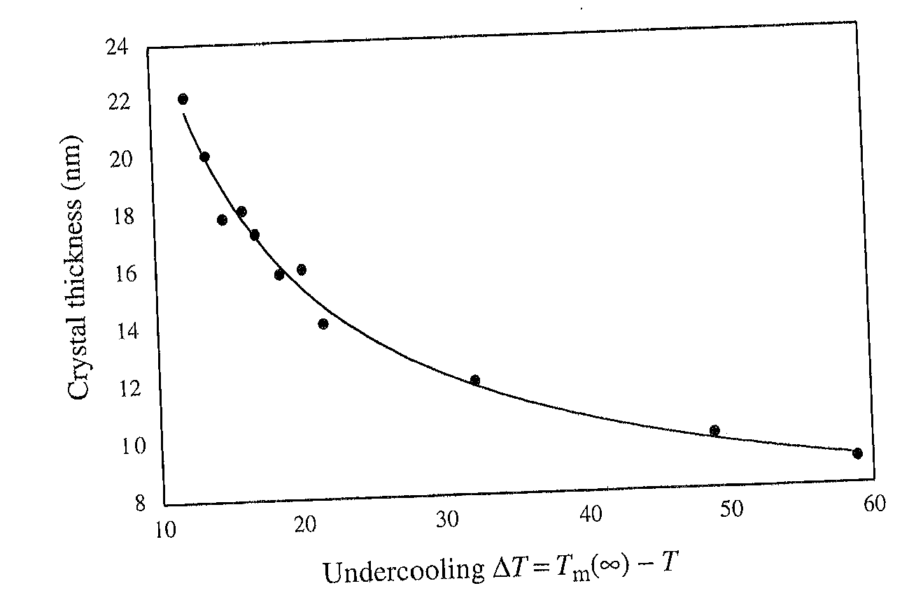
Lamella thickness L* vs. ΔT
(Polyethylene)
(Data from PJ Barham et al.,
J. Mater. Sci. 20, 1625 (1985))
Good fit to A + B/ΔT
Lamella, not spherulite, size!
Large lamella ←→ small ΔT
But slow growth near T_{m}(∞)
Taken from SCM

Slide 26
Max. growth rate ν vs. T_{C} / ΔT We now know which L = L* grows fastest for given ΔT But for what ΔT is ν maximum?
→ Assume VF scaling for rate, τ⁻¹
… difficult to find T_{max} analytically,
but expression is dominated by product of a rising (with T),
and a falling, expt’al. T_{max} somewhere above T_{g}, below T_{m}(∞)

Slide 27
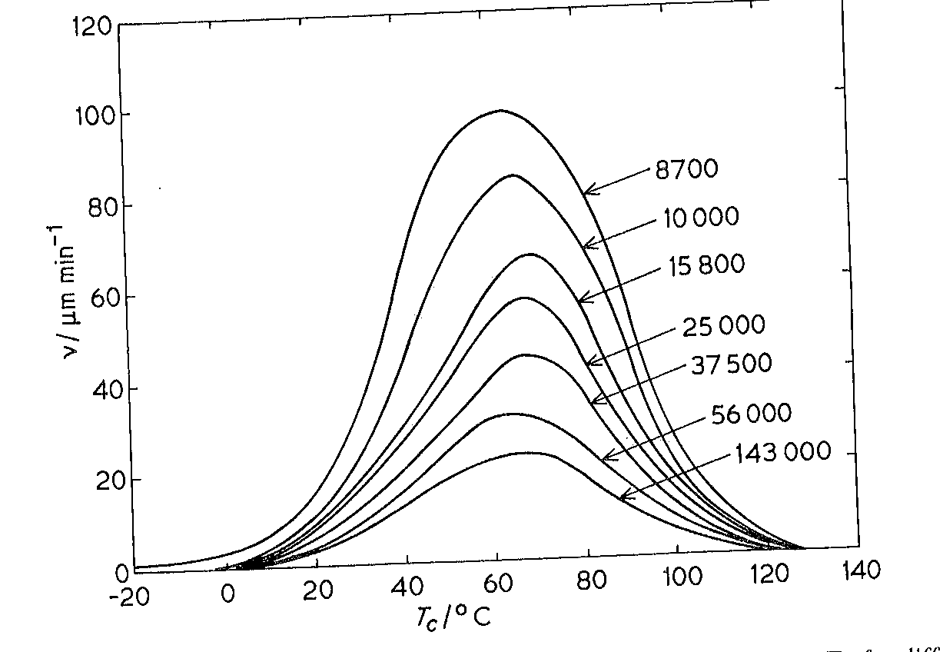
Growth rate ν vs. T_{C}
From RL Young,
‘Introduction to Polymers’
ν(spherulite) vs. T for a polysiloxane, different Mol. Wt. (N)
Peaks in btwn T_{g} and T_{m}(∞)
Btw: Very rough guide, T_{g} ≈ 0.6T_{m}(∞)

Slide 28
Summary: Lecture #14 Polymer Crystallisation II
Straightening stems from coil needs activation entropy
- Limits lamella thickness, L: Too thick lamellae grow slowly
Straightened stems joining lamella delivers enthalpy
- Favours larger L: Too thin lamellae grow slowly
At given ΔT, lamella thickness L* = A + B/ΔT grows fastest
→ L* lamellae dominate, typically L* ≈ (10 … 20) nm
Lamella growth rate ν peaks below T_{m}(∞) / above T_{g}
- To close to T_{m}(∞): Slow crystallisation due to small free energy gain
- To close to T_{g}: High viscosity slows crystallisation
→ Limited ‘T window’ for polymer crystallisation, ‘Quenching’
The material contained within this lecture can be found in SCM chapter 8.3

